Slide 1
On-Prem COB Subrogation and TPL end to end workflow
Prepared by : Rutvi Mistry (Rutvi.Mistry@cotiviti.com)
02/06/2023

Slide 2

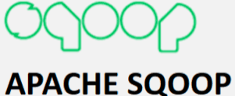





Technologies used
Oozie for workflow scheduling
Sqoop for big data transfer
Kafka for triggering events
Scala for transformation
Spark for data engineering and manipulation
DataRobot for data science and data modeling
Hadoop for HDFS file storage

Slide 3
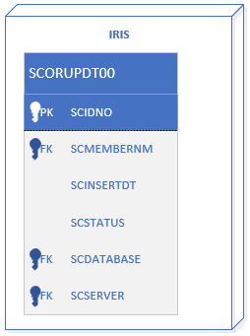
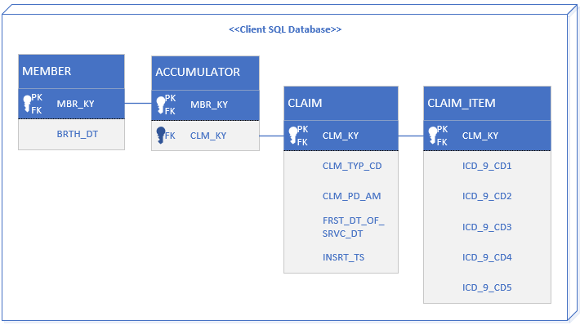
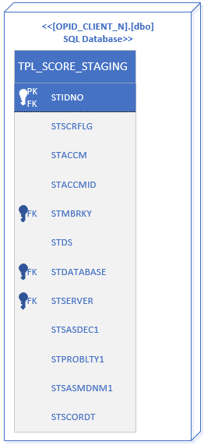
TPL Accent System flow
The incoming oozie pipeline is scheduled using oozie workflow events/ crontab that runs four times per day at 9am, 12pm, 4pm and 7pm
At the start of the pipeline, it looks for member name with SCSTATUS in ‘PENDNG’ state on postgres server for IRIS database
Once it finds member name is in PENDNG state, we grab 4 tables from client database(Member Key) from SQL Server and merge those tables into one.
We run our outgoing pipeline and push results back to SQL Server in database [OPID_CLIENT_N] and table [dbo].[TPL_SCORE_STAGING] for business use

Slide 4


On-Prem TPL End-to-end Workflow
Data Integration team
MLOps Team
Feature Library Team
Data Scientist Team
HMS SSIS Team
Triggers everyday at 9 am, 12 pm,
4 pm and 7 pm
Creates all pending clients' files in one hdfs folder location
Check IRIS Database scorupdt00
Start incoming oozie pipeline
Push all pending clients' files to a folder
Pre-Transformation on all pending clients
Post-Transformation on all pending clients
Scoring
Check for any client is in pendng status
for all pending clients it push data in one folder consisting one file per client
This gets data from individual client database from SQL server and merge all 4 tables into one for transformation
Runs model to score all pending client files
Consumes all pending client files from one hdfs folder and runs transformation on files present in hdfs folder location
Run post transformation on scored results
Send Kafka Trigger for Transformation and Scoring
Stop Execution
Start outgoing oozie pipeline
Creates decile score file for all clients merged in one
Updates SQL Server Database OPID_CLIENT_N and table [dbo].[TPL_SCORE_STAGING]
Send file as trigger to SSIS Package
Grab a final score file and send score to SQL server database and send trigger for SSIS package
Merge of all client scores in one file
Send Kafka Trigger for Outgoing pipeline

Slide 5
On-Prem TPL End-to-end Workflow with Data Validation
Data Integration team
MLOps Team
Feature Library Team
Data Scientist Team
HMS SSIS Team
Triggers everyday at 9 am, 12 pm,
4 pm and 7 pm
Creates all pending clients' files in one hdfs folder location
Check IRIS Database scorupdt00
Start incoming oozie pipeline
Push all pending clients' files to a folder
Pre-Transformation on all pending clients
Post-Transformation on all pending clients
Scoring
Check for any client is in pendng status
for all pending clients it push data in one folder consisting one file per client
This gets data from individual client database from SQL server and merge all 4 tables into one for transformation
Runs model to score all pending client files
Consumes all pending client files from one hdfs folder and runs transformation on files present in hdfs folder location
Run post transformation on scored results
Send Kafka Trigger for Transformation and Scoring
Stop Execution
❶
❷
❸
❹
Start outgoing oozie pipeline
Creates decile score file for all clients merged in one
Updates SQL Server Database OPID_CLIENT_N and table [dbo].[TPL_SCORE_STAGING]
❺
Send file as trigger to SSIS Package
Grab a final score file and send score to SQL server database and send trigger for SSIS package
Merge of all client scores in one file
Send Kafka Trigger for Outgoing pipeline

Slide 6
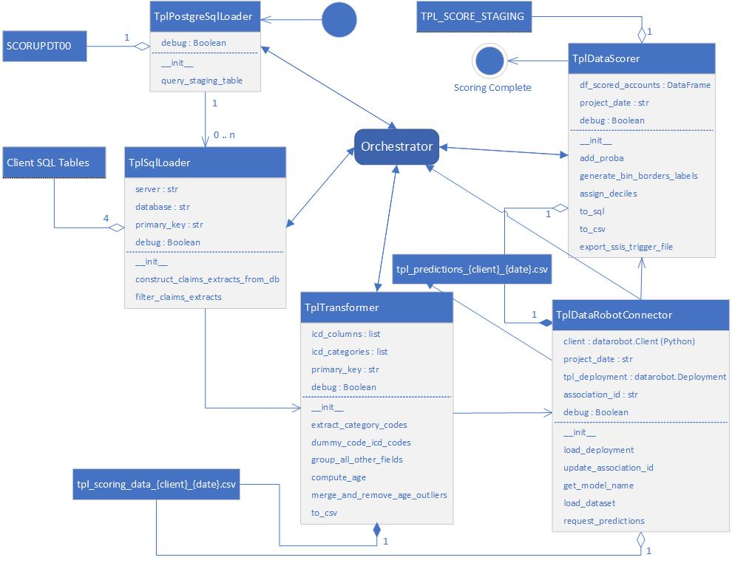
Data Validation Comparison
This UML static model is language independent. The modular design and workflow should be translated as-is.
The results of pipeline stages 1, 2, 4, and 5 must be identical.
The results of stage 3 can be almost equal within a small threshold.
The productized Python code that encapsulates these five stages can be found here.
❺
❹
❸
❶
❷

Slide 7
AI-tpl-DataIncoming Oozie workflow test case
Test Case 1 : When there are no member with scstatus pendng Query to update on postgre for testing: UPDATE "scorupdt00_scorupdt00" SET "scstatus"=‘SCORED' where "scstatus"='PENDNG’
Output : SUCCESS: There are no member_key with scstatus='PENDNG'
Test Case 2 : When there is member with scstatus pendng but doesn’t have database name mentioned in it Query to update on postgre for testing: UPDATE "scorupdt00_scorupdt00" SET "scstatus"='PENDNG' where "scidno"='28908’ //scidno=‘28908’ has no database name
Output :
SUCCESS: Client cannot be scored as there is no Database name in postgres database for client : NTCA

Slide 8
AI-tpl-DataIncoming Oozie workflow test case
Test Case 3: When there are some member with pending status and member details with/without database name Query to update on postgre for testing: UPDATE "scorupdt00_scorupdt00" SET "scstatus"='PENDNG' where "scidno" in ('28908','2447042','2157602','2382960’) //NTCA, DS_NTCA, DS_UPS, DS_MARRIOT
Output : done, DS_SODEXO file exported done, Final file exported done, DS_DEVOTED file exported done, Final file exported Client cannot be scored as there is no Database name in postgres database for client : NTCA final code done
Test Case 4: When all 9 clients are in pending status and member details with/without database name Query to update on postgre for testing: UPDATE "scorupdt00_scorupdt00" SET "scstatus"='PENDNG' where "scidno" in ('28908','2447042','2157602','2382960','2303122','2175055')
//NTCA, DS_NTCA, DS_UPS, DS_MARRIOT, DS_DEVOTED, DS_SODEXO,…. we have 9 current clients: NRECA, UPS, Lumen, NTCA, UHC, Teamster TWRNJ, Sodexo, Marriott, and Devoted.
Output :
done, DS_SODEXO file exported done, Final file exported done, DS_DEVOTED file exported done, Final file exported ….. ….. // for all night clients done, ****** file exported ….. // done Final file exported
Client cannot be scored as there is no Database name in postgres database for client : NTCA
final code done

